Slide 1
ANDROID DEVELOPERS
TEAM LEADER
Ramyasri. K - 1E4AD2E96D028E7807B4C098A38F4DCA
TEAM MEMBERS
Premrajesh. R - 98817BC78152025A0B34EBDC7650566E
Vijayavarman. S - CBCD0E3EEF1D3FABAD64F03FD4E785BF

Slide 2
PROJECT DETAILS
Title : Snacks Squad : A Customisable Snack Ordering and delivering app
Description : A modern snack ordering Android application designed to enhance the food ordering experience. Allows users to register, browse snack options, place orders, and includes admin functionalities to track orders.

Slide 3
Project Workflow :
User Registration: Users create an account to access the app.
User Login: Registered users can log in securely.
Main Page: Displays available snacks with prices and ratings.
Order Placement: Users select items, specify quantity, and provide an address to place an order.
Admin Functionality: Admins can log in to view and track orders placed by users.

Slide 4
Technologies Used :
Language : Kotlin
Database : SQLite (via Room Database)
UI Framework : Jetpack Compose
IDE : Android Studio
Design Principles : MVVM architecture for maintainable and testable code.

Slide 5
MainPage Activity.kotlin
package com.example.snackordering
import android.annotation.SuppressLint
import android.content.Context
import android.os.Bundle
import android.widget.Toast
import androidx.activity.ComponentActivity
import androidx.activity.compose.setContent
import androidx.annotation.DrawableRes
import androidx.annotation.StringRes
import androidx.compose.foundation.Image
import androidx.compose.foundation.background
import androidx.compose.foundation.layout.*
import androidx.compose.foundation.shape.CircleShape
import androidx.compose.foundation.shape.RoundedCornerShape
import androidx.compose.material.*
import androidx.compose.material.icons.Icons
import androidx.compose.material.icons.filled.*
import androidx.compose.runtime.Composable
import androidx.compose.ui.Alignment
import androidx.compose.ui.Modifier
import androidx.compose.ui.draw.clip
import androidx.compose.ui.graphics.Color
import androidx.compose.foundation.lazy.LazyColumn
import androidx.compose.foundation.lazy.items

Slide 6
import androidx.compose.material.Text
import androidx.compose.ui.unit.dp
import androidx.compose.ui.graphics.RectangleShape
import androidx.compose.ui.layout.ContentScale
import androidx.compose.ui.platform.LocalContext
import androidx.compose.ui.res.painterResource
import androidx.compose.ui.res.stringResource
import androidx.compose.ui.text.font.FontWeight
import androidx.compose.ui.unit.sp
import androidx.core.content.ContextCompat.startActivity
import com.example.snackordering.ui.theme.SnackOrderingTheme
import android.content.Intent as Intent1
class MainPage : ComponentActivity() {
override fun onCreate(savedInstanceState: Bundle?) {
super.onCreate(savedInstanceState)
setContent {
SnackOrderingTheme {
// A surface container using the 'background' color from the theme
Surface(
modifier = Modifier.fillMaxSize(),
color = MaterialTheme.colors.background
) {

Slide 7
FinalView(this)
val context = LocalContext.current
//PopularFoodColumn(context)
}
}
}
}
}
@Composable
fun TopPart() {
Row(
modifier = Modifier
.fillMaxWidth()
.background(Color(0xffeceef0)), Arrangement.SpaceBetween
) {
Icon(
imageVector = Icons.Default.Add, contentDescription = "Menu Icon",
Modifier
.clip(CircleShape)
.size(40.dp),
tint = Color.Black,
)

Slide 8
Column(horizontalAlignment = Alignment.CenterHorizontally) {
Text(text = "Location", style = MaterialTheme.typography.subtitle1, color = Color.Black)
Row {
Icon(
imageVector = Icons.Default.LocationOn,
contentDescription = "Location",
tint = Color.Red,
)
Text(text = "Accra" , color = Color.Black)
}
}
Icon(
imageVector = Icons.Default.Notifications, contentDescription = "Notification Icon",
Modifier
.size(45.dp),
tint = Color.Black,
)
}
}
@Composable
fun CardPart() {

Slide 9
Card(modifier = Modifier.size(width = 310.dp, height = 150.dp), RoundedCornerShape(20.dp)) {
Row(modifier = Modifier.padding(10.dp), Arrangement.SpaceBetween) {
Column(verticalArrangement = Arrangement.spacedBy(12.dp)) {
Text(text = "Get Special Discounts")
Text(text = "up to 85%", style = MaterialTheme.typography.h5)
Button(onClick = {}, colors = ButtonDefaults.buttonColors(Color.White)) {
Text(text = "Claim voucher", color = MaterialTheme.colors.surface)
}
}
Image(
painter = painterResource(id = R.drawable.food_tip_im),
contentDescription = "Food Image", Modifier.size(width = 100.dp, height = 200.dp)
)
}
}
}
@Composable
fun PopularFood(
@DrawableRes drawable: Int,
@StringRes text1: Int,
context: Context
) {

Slide 10
Card(
modifier = Modifier
.padding(top=20.dp, bottom = 20.dp, start = 65.dp)
.width(250.dp)
) {
Column(
verticalArrangement = Arrangement.Top,
horizontalAlignment = Alignment.CenterHorizontally
) {
Spacer(modifier = Modifier.padding(vertical = 5.dp))
Row(
modifier = Modifier
.fillMaxWidth(0.7f), Arrangement.End
) {
Icon(
imageVector = Icons.Default.Star,
contentDescription = "Star Icon",
tint = Color.Yellow
)
Text(text = "4.3", fontWeight = FontWeight.Black)
}
Image(
painter = painterResource(id = drawable),
contentDescription = "Food Image",
contentScale = ContentScale.Crop,

Slide 11
modifier = Modifier
.size(100.dp)
.clip(CircleShape)
)
Text(text = stringResource(id = text1), fontWeight = FontWeight.Bold)
Row(modifier = Modifier.fillMaxWidth(0.7f), Arrangement.SpaceBetween) {
/*TODO Implement Prices for each card*/
Text(
text = "$50",
style = MaterialTheme.typography.h6,
fontWeight = FontWeight.Bold,
fontSize = 18.sp
)
IconButton(onClick = {
//var no=FoodList.lastIndex;
//Toast.
val intent = Intent1(context, TargetActivity::class.java)
context.startActivity(intent)
}) {
Icon(
imageVector = Icons.Default.ShoppingCart,

Slide 12
contentDescription = "shopping cart",
)
}
}
}
}
}
private val FoodList = listOf(
R.drawable.sandwish to R.string.sandwich,
R.drawable.sandwish to R.string.burgers,
R.drawable.pack to R.string.pack,
R.drawable.pasta to R.string.pasta,
R.drawable.tequila to R.string.tequila,
R.drawable.wine to R.string.wine,
R.drawable.salad to R.string.salad,
R.drawable.pop to R.string.popcorn
).map { DrawableStringPair(it.first, it.second) }
private data class DrawableStringPair(
@DrawableRes val drawable: Int,
@StringRes val text1: Int
)
@Composable
fun App(context: Context) {
Column(
modifier = Modifier

Slide 13
.fillMaxSize()
.background(Color(0xffeceef0))
.padding(10.dp),
verticalArrangement = Arrangement.Top,
horizontalAlignment = Alignment.CenterHorizontally
) {
Surface(modifier = Modifier, elevation = 5.dp) {
TopPart()
}
Spacer(modifier = Modifier.padding(10.dp))
CardPart()
Spacer(modifier = Modifier.padding(10.dp))
Row(modifier = Modifier.fillMaxWidth(), Arrangement.SpaceBetween) {
Text(text = "Popular Food", style = MaterialTheme.typography.h5, color = Color.Black)
Text(text = "view all", style = MaterialTheme.typography.subtitle1, color = Color.Black)
}
Spacer(modifier = Modifier.padding(10.dp))
PopularFoodColumn(context) // <- call the function with parentheses
}
}
@Composable
fun PopularFoodColumn(context: Context) {

Slide 14
LazyColumn(
modifier = Modifier.fillMaxSize(),
content = {
items(FoodList) { item ->
PopularFood(context = context,drawable = item.drawable, text1 = item.text1)
abstract class Context
}
},
verticalArrangement = Arrangement.spacedBy(16.dp))
}
@SuppressLint("UnusedMaterialScaffoldPaddingParameter")
@Composable
fun FinalView(mainPage: MainPage) {
SnackOrderingTheme {
Scaffold() {
val context = LocalContext.current
App(context)
}
}
}

Slide 15
Android Mainfest.xml
<?xml version="1.0" encoding="utf-8"?>
<manifest xmlns:android="http://schemas.android.com/apk/res/android"
xmlns:tools="http://schemas.android.com/tools">
<application
android:allowBackup="true"
android:dataExtractionRules="@xml/data_extraction_rules"
android:fullBackupContent="@xml/backup_rules"
android:icon="@drawable/fast_food"
android:label="@string/app_name"
android:supportsRtl="true"
android:theme="@style/Theme.SnackOrdering"
tools:targetApi="31">
<activity
android:name=".AdminActivity"
android:exported="false"
android:label="@string/title_activity_admin"
android:theme="@style/Theme.SnackOrdering" />
<activity
android:name=".LoginActivity"
android:exported="true"
android:label="SnackSquad"
android:theme="@style/Theme.SnackOrdering">

Slide 16
<intent-filter>
<action android:name="android.intent.action.MAIN" />
<category android:name="android.intent.category.LAUNCHER" />
</intent-filter>
</activity>
<activity
android:name=".TargetActivity"
android:exported="false"
android:label="@string/title_activity_target"
android:theme="@style/Theme.SnackOrdering" />
<activity
android:name=".MainPage"
android:exported="false"
android:label="@string/title_activity_main_page"
android:theme="@style/Theme.SnackOrdering" />
<activity
android:name=".MainActivity"
android:exported="false"
android:label="MainActivity"
android:theme="@style/Theme.SnackOrdering" />
</application>
</manifest>

Slide 17
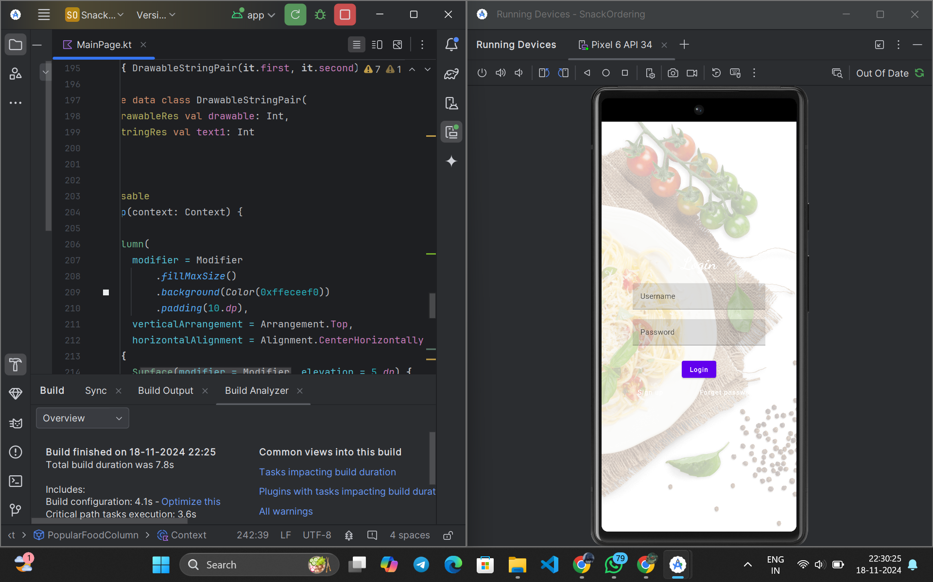
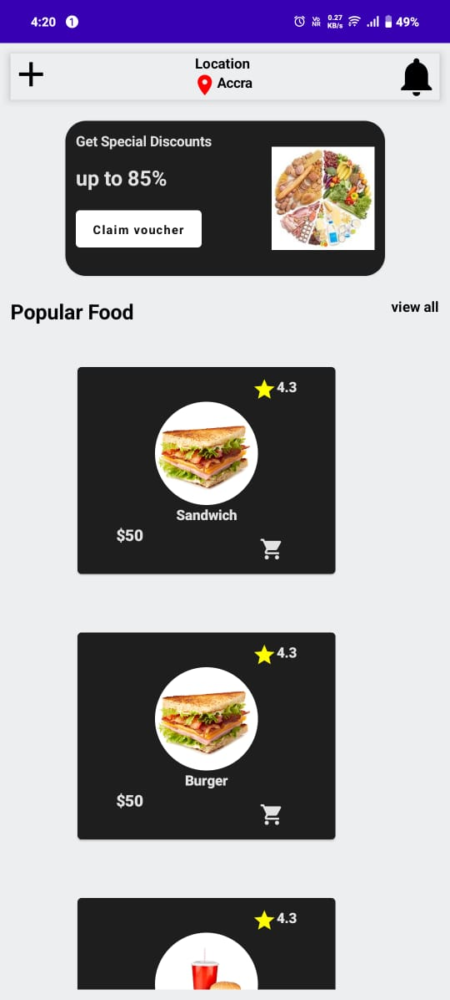
OUTPUT:

Slide 18
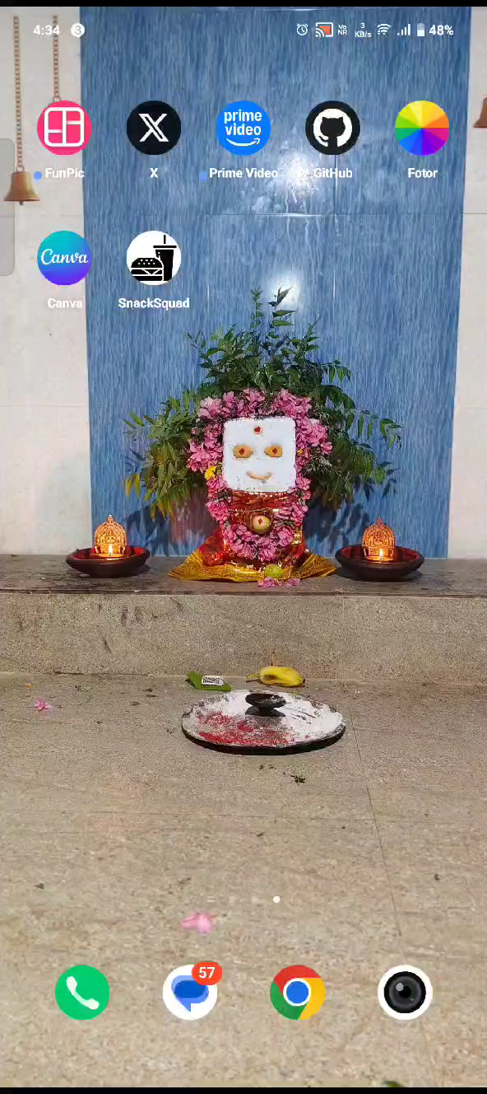

Slide 19
THANK YOU…

